Slide 1
HEART DISEASE DETECTION USING APACHE SPARK AND KAFKA
Project Batch Number: 225
Rohan Talaka (160118737106)
Sk Sameer (160118737110)
Guide: Dr. M Venu Gopalachari,
Associate Professor.

Slide 2
CONTENTS
Introduction
Literature Survey
System Requirements
System Design
Methodology
Algorithms
Implementation
Results
Conclusion
Future Scope

Slide 3
INTRODUCTION
A number of technologies enabled by IoT have been used for prevention of various chronic diseases, continuous and real-time tracking system is a particularly important one.
The huge amount of data which is collected is often called as streaming big data.
Due to the higher speed of the data generation, it is difficult to collect, process and analyze such massive data in real-time in order to perform real-time actions in case of emergencies and extracting hidden value, using traditional methods which are limited and time-consuming.
To deal with a problem, there is an essential need of detection system for awareness about diseases.

Slide 4
LITERATURE SURVEY
Title | Author | Description | Pros and Cons
Heart Disease Prediction Using Machine Learning Algorithms IEEE, ICE3-2020 | Archana Singh, Rakesh Kumar | In this system, the accuracy of the machine learning algorithms for predicting heart disease, is detected. The algorithms used are k-nearest neighbor, decision tree, linear regression and support vector machine(SVM) by using UCI repository dataset for training and testing. | The algorithms work on the same data and the one with highest accuracy is used to predict/detect for the new data provided. Real time data cannot be handled. handled.
Early Heart Disease Detection Using Data Mining Techniques with Hadoop Map Reduce IJPAM 2018 | S.Bagavathy, V.Gomathy, S.Sheeba Rani, Sujatha.K Bhuvana.M., Monica.Murugesan | This real-time heart detection system is based on apache storm which stand as a strong large scale distributed computing platform that can be used successfully for streaming data event against machine learning . The system consists of two main sub parts, namely streaming processing and machine learning models. | The algorithm uses Strom for real time processing and Mahoot for Machine Learning and it uses Hive for processing the structural data. It takes more time to process.

Slide 5
Title | Author | Description | Pros and Cons
Big Data Analysis For Heart Disease Detection System Using Map Reduce Technique IEEE, ICE3-2020 | G Vaishali, V. Kalaivani | In this system, large set of medical records are taken as input. From the medical dataset, it is aimed to extract the needed information from the record of heart patients using map reduce technique. | The algorithm uses Strom for real time processing and Mahoot for Machine Learning and it uses Hive for processing the structural data. It takes more time to process as we are using map reduce.
Real-time machine learning for early detection of heart disease using big data approach IEEE 2019 | Abderrahmane Ed-daoudy, Khalil Maalmi | This real-time heart detection system is based on apache Spark which stand as a strong large scale distributed computing platform that can be used successfully for streaming data event against machine learning through in-memory computations. The system consists of two main sub parts, namely streaming processing and data storage and visualization | The system focuses on applying real time classification model on heart disease attributes for continuous monitoring of the patient’s health. The dataset is small
Machine Learning Based Method for Prediction of Heart Disease in Big Data Environment IJITEE 2020 | Sharmila Rengasamy, Chellammal Surianarayanan, Pethuru Raj Chellaih | An approach for prediction of heart diseases using SVM from Spark MLLib has been proposed in order to apply of in-memory concept of Spark. The model has been tested with 297 records. In addition, it is planned to split the data into different nodes and analyse impact of big data tools in the accuracy of prediction. | It uses big data technology like spark so the processing is faster, unlike traditional techniques. It uses only svm there might be other algorithms which give better accuracy

Slide 6
SYSTEM REQUIREMENTS
SOFTWARE REQUIREMENTS
Ubuntu 16.04.1 LTS
Apache Zookeeper
Kafka
Spark
Hadoop
HARDWARE REQUIREMENTS
Processor: i5 and above
RAM: 8 GB and above
Hard disk:120 GB

Slide 7
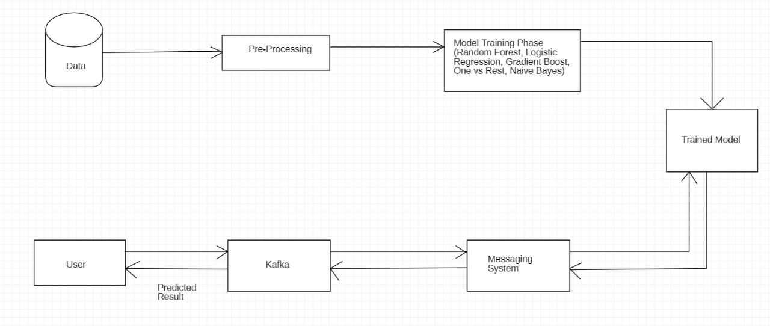
System Design

Slide 8
METHODOLOGY
Proposed System
The initial step in the framework is collecting data from UCI repository. The second step is pre-processing where the null values is removed from the data-set and need to convert some category values to fake values in the form of "0" and "1". The third step is training the machine learning models like Random Forest, logistic regression, decision tree, linear support vector machine, gradient boost. The fourth step is creating a UI where user can enter the attributes of the heart disease and creating a kafka topic to store the user data in the message system. The data is streamed by spark by using topic name and it is tested against the stored data using the trained model. Then the predicted result is streamed back and displayed to the user. Since Kafka combines messaging, storage and stream processing to allow storage and analysis of both historical and real-time data, it can help do the processing faster and more accurately.

Slide 9
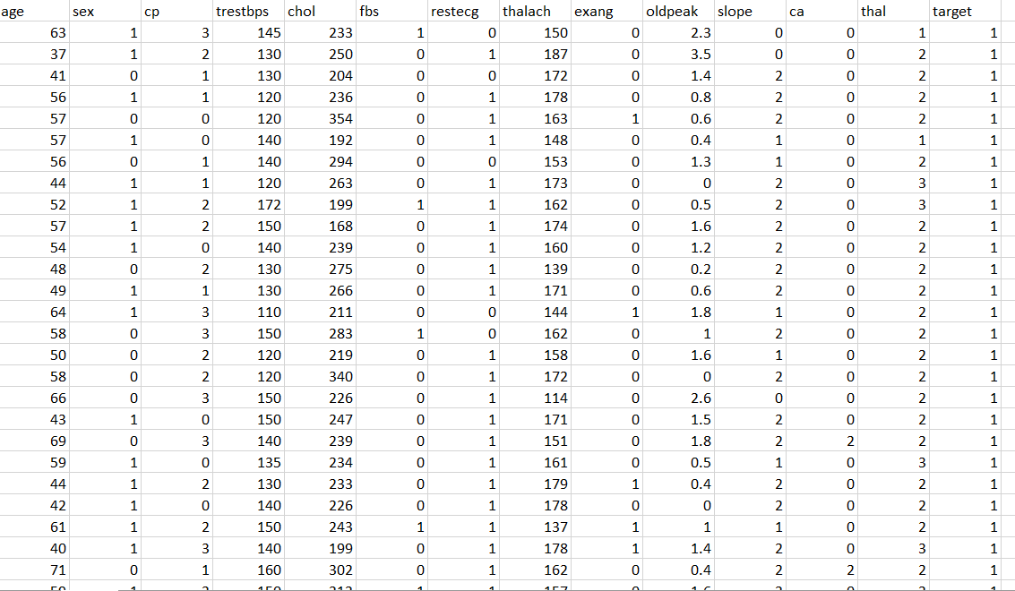
Dataset
The data-set is freely available and used in the majority of research papers is the heart disease data-set obtained from the UCI (University of California, Irvine C.A) has been used. There are 303 records in this database. This database is divided in the ratio 70-30 for training and testing purposes respectively. Each record in the database has fourteen attributes.

Slide 10
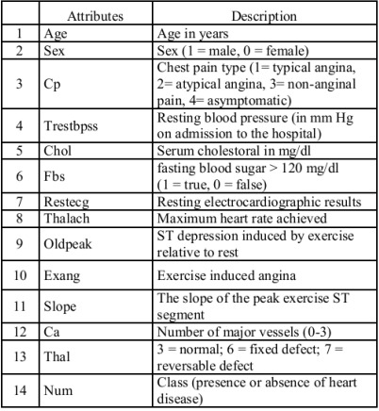

Slide 11
ALGORITHM
The algorithm used in this project is Random Forest classifier algorithm. Random Forest is a classifier that contains a number of decision trees on various subsets of the given data-set and takes the average to improve the predictive accuracy of that data-set. A random forest eradicates the limitations of a decision tree algorithm. Decision tree suffer from low bias and high variance. Random forest converts high variance to low variance. The greater number of trees in the forest leads to higher accuracy and prevents the problem of over-fitting. It generates predictions without requiring many configurations in packages.

Slide 12
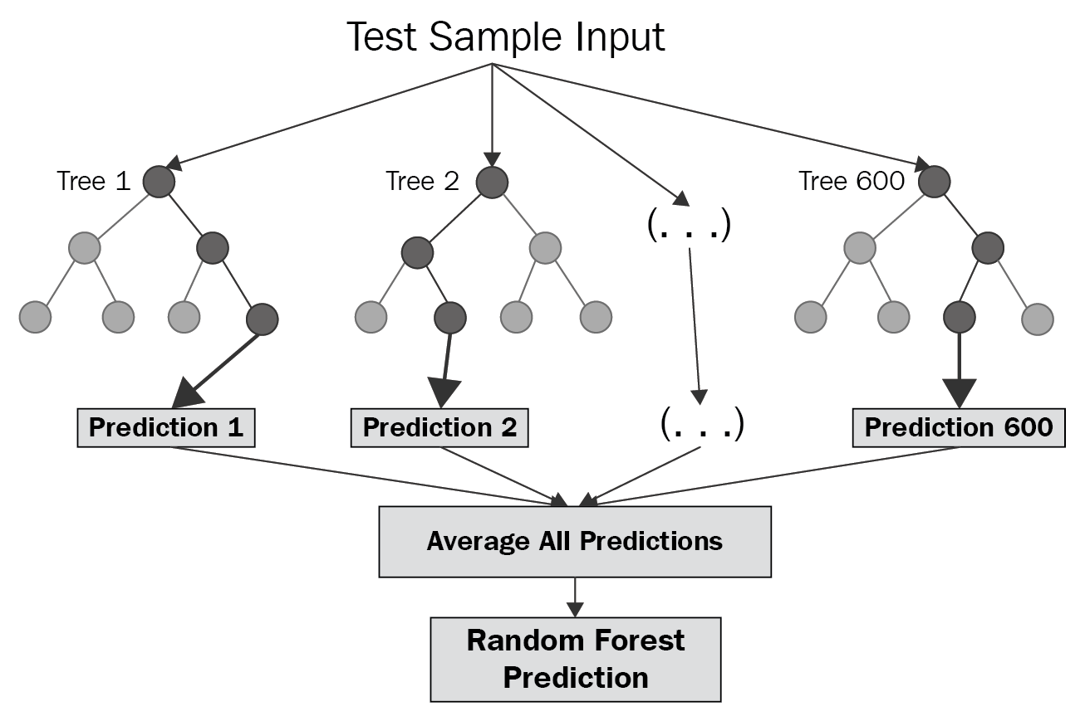
Working of Random Forest Algorithm

Slide 13
IMPLEMENTATION
The proposed work is implemented in three modules. The first module is data collection and pre-processing, the second module is training machine learning models and the third module is spark streaming and Kafka.
MODEL IMPLEMENTATION
Setting up Spark Context and kafka
Importing Dependencies
Loading and extracting attributes
Pre-processing data
Model Training Phase using training data
Using the model
spark streming and kafka

Slide 14
IMPLEMENTATION OF RANDOM FOREST
We need to load the dataset first. During the first step, we need to load the training as well as the test data.
The following steps are followed during implementation:
Start with the selection of random samples from a given dataset.
Next, this algorithm will construct a decision tree for every sample. Then it will get the prediction result from every decision tree.
In this step, voting will be performed for every predicted result.
At last, select the most voted prediction result as the final prediction result.

Slide 15
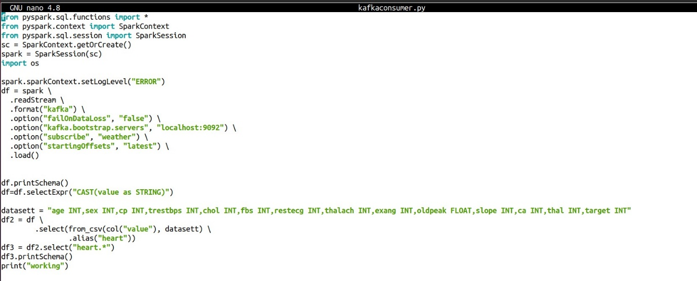
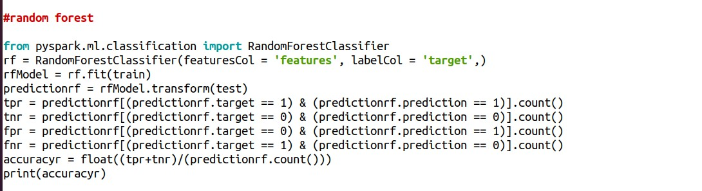
Creating a Kafka topic and streaming the data
Implementing the random forest trained model

Slide 16
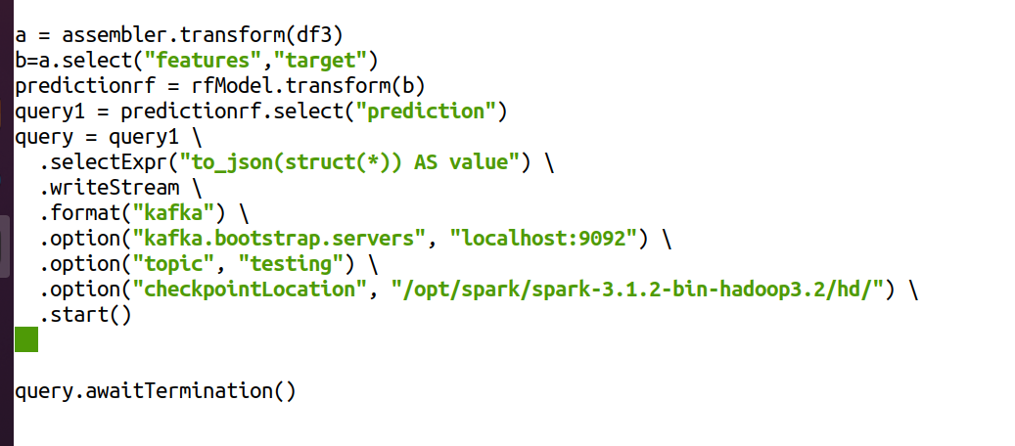
Writing the predicted data to Kafka

Slide 17
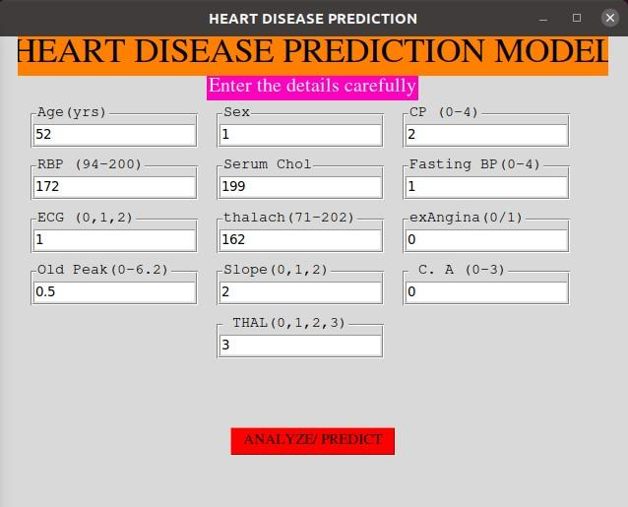
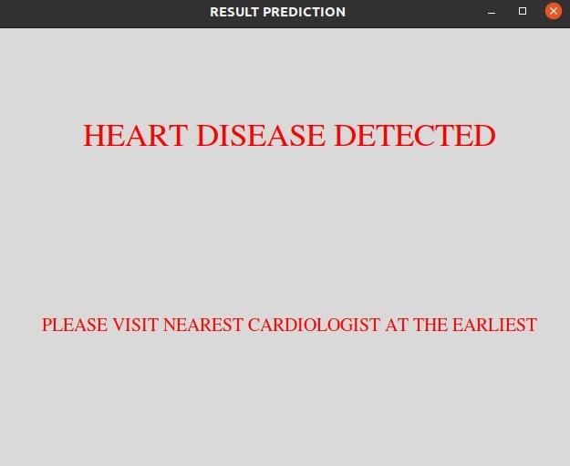
RESULTS
The User Interface
The output displaying the presence of heart disease based on the details provided by the user

Slide 18
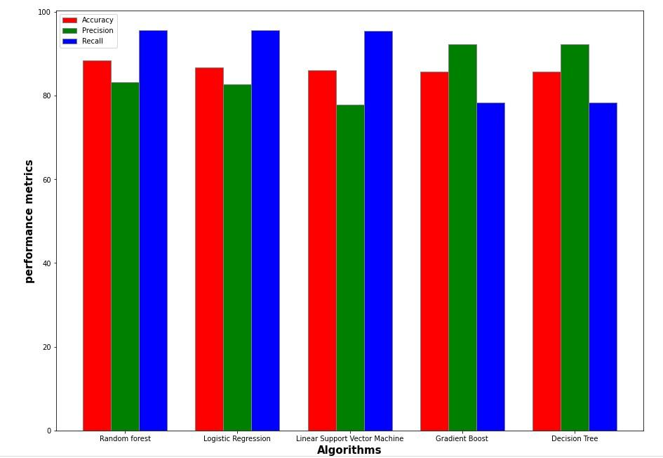
Graph representation of the performance metrics of the algorithms

Slide 19
CONCLUSION AND FUTURE SCOPE
Developing a distributed and real-time healthcare analytics system using traditional analytical tools is extremely complex, while exploiting open source big data technologies can do it in a simpler and more effective way. For the current system, Random Forest has shown a higher accuracy compared to the other algorithms.
The dataset used in the current process is historical data. So, in order to increase the accuracy of the model, the data from IoT Devices, Medical Devices, Streaming Systems, etc, can be streamed in real-time through Kafka and Apache Spark. This will help get faster and accurate results with more efficiency.
The current proposed system has only one node. More data can be collected and used through connection with multiple clusters. Having multiple clusters can help improve scalability and performance of the system.

